Slide 1

Martin Martinkovic martin.martinkovic@sk.ibm.com
IBM Academic Relations
IBM Academic Initiative

Slide 2


The IBM Academic Initiative enables students and faculties to access select IBM resources through a free self-service program that will provide them with the skills to differentiate themselves in their career.
Access to the IBM Cloud and select cloud-based resources and applications
Access to the commercial grade software used by IBM’s commercial customers
Get started by visiting ibm.com/academic
Notes:
Data Science, Cloud Computing, Blockchain and Artificial Intelligence are the among the most highly valued skills by employers today, and universities are not keeping pace with technology advances.
---
As industries are reshaped by new technologies such as data science, cloud computing, blockchain, and artificial intelligence, the number of jobs being created is far outpacing the number of qualified applicants.
Technology is changing so quickly that there are jobs being augmented by technology that the workforce is not equipped with the necessary skills to meet those job requirements.
Recent information provided by Code.org and the US Bureau of Labor Statistics projects that by 2020 as many as 1 million computer science related jobs will be unfilled.
Source: https://code.org/files/Code.orgOverview.pdf
Source: https://obamawhitehouse.archives.gov/blog/2013/12/11/computer-science-everyone
Source: https://www.bls.gov/news.release/archives/ecopro_02012012.pdf
While some of these positions require advanced education, many do not.
With the drastic shortage of workers, companies are now focusing on skills-based hiring to fill these roles.
For example, according to a 2017 report by the Information Systems Audit and Control Association (ISACA), 55 percent of security hiring managers say practical, hands-on experience is the most important qualification for a candidate.
Source: https://www.eweek.com/security/industry-group-exposes-skills-gap-for-cyber-security-jobs
Source: http://www.isaca.org/Knowledge-Center/Research/Documents/state-of-cybersecurity-2017_res_eng_0217.pdf?regnum=487009
---
In order to help students and faculty bridge the skills gap IBM created the IBM Academic Initiative.
Originally established in 2004, the IBM Academic Initiative allowed and encouraged faculty and researchers to leverage IBM tools, courses, and other resources in the classroom.
In 2016 we expanded the program, giving students direct access to IBM resources.
The goal of the IBM Academic Initiative continues to be the enablement of students to graduate with direct hands-on experience on "industrial strength" tools that will help them in their chosen career.
Through a self-service portal, students and faculty may access select IBM resources at no-charge for teaching, learning and non-commercial research use at accredited academic institutions.
---
The resources provided through the IBM Academic Initiative come in three (3) categories.
Most resources are available for the length of time a student or faculty member is at the accredited academic institution.
Several resources will require periodic renewals for continued use.
Cloud Access – This is access to select cloud based resources and applications.
The IBM Cloud where students and faculty can access usage-capped services at no-charge through an IBM Cloud Lite account or augment that experience by applying an IBM Cloud Promo code to gain access to additional Cloud Foundry memory and services.
Gain access to services like Watson Assistant so that you can build conversational interfaces into any application, device, or channel
Use Visual Recognition to find meaning in visual content. Analyze images for scenes, objects, faces, and other content and develop smart applications that analyze the visual content of images or video frames to understand what is happening in a scene.
Our LinuxOne Community Cloud is where students and faculty can get renewable 120 day access to a 2vCPU, 4GB Memory and 45GB storage Virtual Machine (VM) running on a Linux One mainframe using your choice of Red Hat or SuSE Linux.
Software-as-a-Service offerings like Watson Studio Desktop for solving your business problems by analyzing data with artificial intelligence are also available. With Watson Studio, you can prepare data and build models on your desktop with visual drag and drop tools.
Software – This is the same software used by our enterprise customers, not restricted version.
Use tools like SPSS Modeler for data preparation and discovery, predictive analytics, model management and deployment.
Use ILOG CPLEX Optimization Studio to optimize your business decisions, develop and deploy optimization models quickly, and create real-world applications that can significantly improve business outcomes
Use DB2 to add an enterprise ready database to your application or project.
Courseware – These are the same courses we teach and sell to our enterprise customers
While this category is limited to faculty only, we provide student and instructor guide as well as exercises and lab setup files so that you can incorporate these course materials in whole or in part into existing curriculum.
Learn product fundamentals with courses like IBM QRadar SEIM Foundations
Take a deep dive into the IBM Z operating system with z/OS Unix System Services
Or learn advanced reporting with IBM Cognos Analytics: Author Reports with Multidimensional Data
---
To get started visit ibm.com/academic
You will need to register with your school issued email address
Once registered you can access any of our select resources ranging from from traditional enterprise infrastructure to cloud computing to leading edge technologies like Blockchain and Quantum Computing

Slide 3
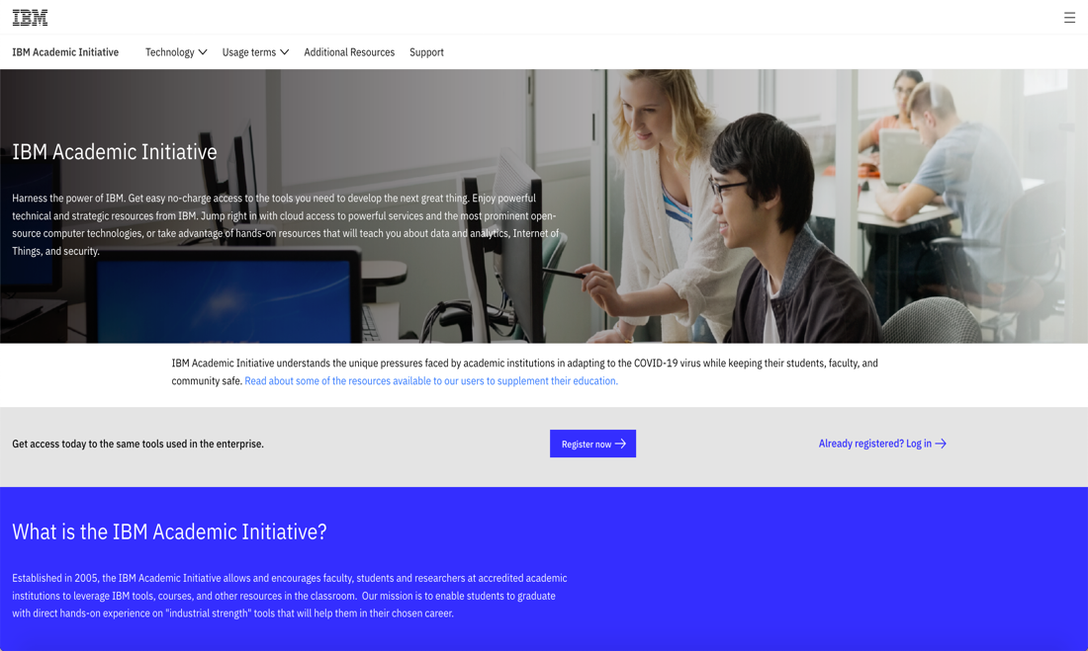
Let us Register now!
Step 1: Open the IBM Academic Initiative website: http://ibm.com/academic in a web browser
Step 2: Click the “Register” Now button

Slide 4
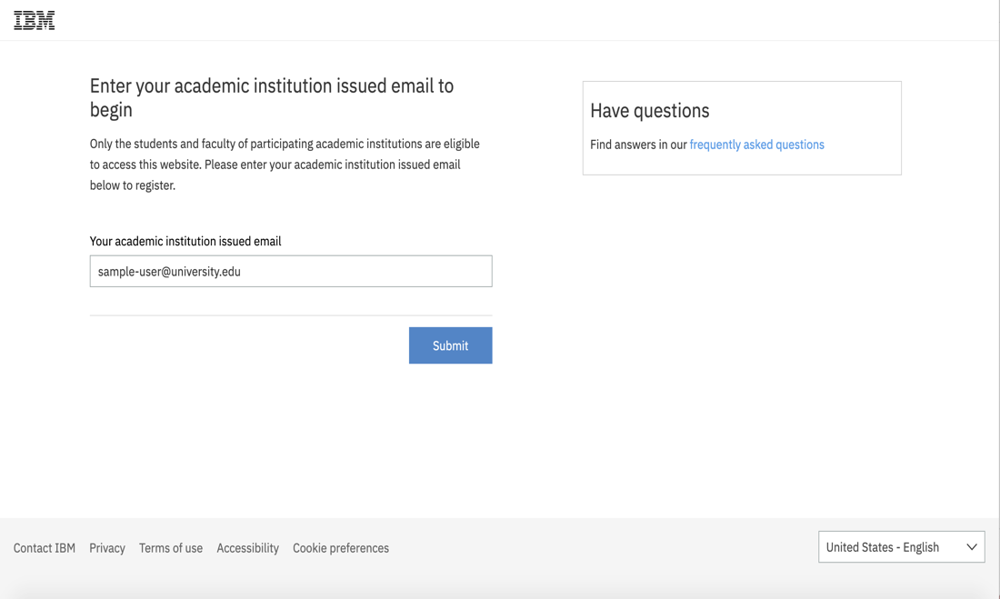
Step 3: Enter your university issued email address.
For example username@university.ac.ke

Slide 5
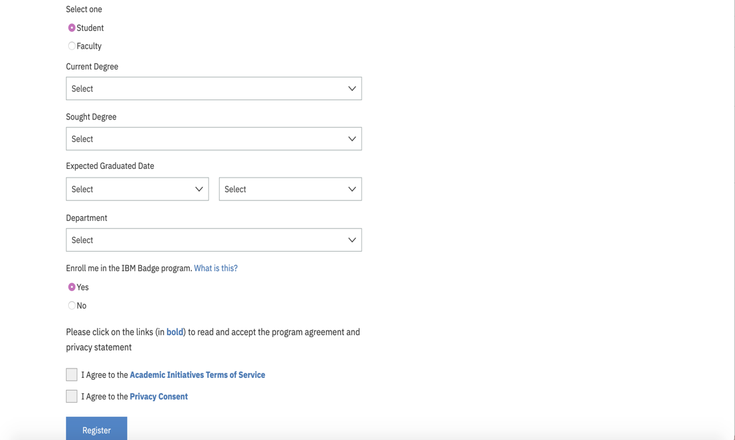
Step 4: Select whether you are a student or faculty member
As a Student…
Step 5:
Fill in the required information

Slide 6
Step 6: Agree to the IBM Academic Initiative Agreement and Privacy Statement
Step 7:
Click the Register button
*Note: Click on bold text , review the text for the checkbox to be active

Slide 7
Step 8a: If you already have an IBMid with the academic institution issued email address you will be asked to login with that account at this time.
Step 8b: If you do not have an IBMid with the academic institution issued email address you will be asked to create one at this time.
Step 9: Return to the IBM Academic Initiative website and login and you are done!! Easy as that. Now you can download
-software
-Course ware
-Cloud Access
Notes:
Make a Poll.for the students.
Did you complete registration successfully?
Lets download IBM an Cloud Promo-Code

Slide 8
Software available through the IBM Academic Initiative
Data Science and AI
Watson Studio Desktop
SPSS Modeler
Cognos Analytics
ILOG CPLEX
Streams
Watson Explorer
PowerAI Vision
Video Analytics
Watson Machine Learning Accelerator
Db2 Big SQL
Cloud Pak for Data
Databases
Db2
Db2 Event Store
Informix
Security
QRadar
Guardium
Cloud Pak for Security
Mobile/IoT
Mobile Foundation
Watson IoT Platform - Message Gateway
Infrastructure Management
Spectrum LSF Suite for HPC
Spectrum Conductor
Cloud Pak for Multicloud Management
Software Development
WebSphere
Rational
MQ
Engineering and Scientific Subroutine Library
Cloud Pak for Integration

Slide 9

THANK YOU martin.martinkovic@sk.ibm.com

